Slide 1

Automatic Ticket Assignment
Capstone project – Automating IT ticket assignment using advanced machine learning algorithms
By,
Madhumitha.R
Harika.M
Deepkumar Aravindkumar Patel
Rachit Vaid

Slide 2
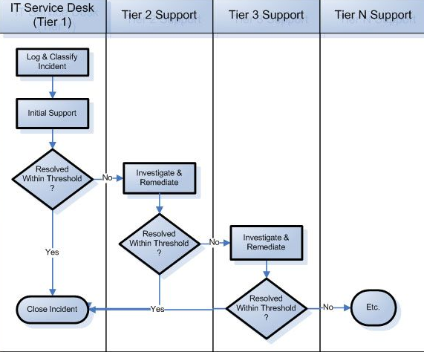
INCIDENT MANAGEMENT PROCESS
Incident - An unplanned interruption to an IT service that affects the Users and impacts the Business
Incident Management – Provide fixes resolving the incident to restore the service to its full capacity
Aims to ensure no business impact and uninterrupted service continuity.
Incident Management Process – Service tickets raised by users are assigned to related IT groups for incident resolution.
Traditionally, group are assigned manually.

Slide 3
Problem Statement
Proposed solution
Issues with manual assignment
Time consuming
Human resource intensive
Susceptible to human error (approximately 25% of incidents are considered to be wrongly assigned to functional teams)
Can lead to deterioration in user satisfaction
Automate the assignment process
Drastic reduction in Time consumption
Cost saving/cutting
Eliminates human error(Better model accuracy)
Improved customer satisfaction

Slide 4
Solution METHODOLOGY
Verify data quality
Data pre-processing
Clean, format data
Tokenization, remove stop words, normalization, stemming & lemmatization, feature engineering (TF-IDF, N-gram, GloVe)
Modelling
Evaluation
Accuracy, Precision, recall, F1-score, AUC, val-loss
Understand data structure
Perform EDA
Finalize dataset
Train/test data split
Alter hyper parameters, find better working model
Deployment
User Integration
Analyze production environment
Monitoring and maintenance
Use NLP models like RNN’s, LSTMS and other advanced models
Data Analysis
Business Understanding
Determine the business objective
Set overall goals to achieve
Finalize on milestones to target

Slide 5
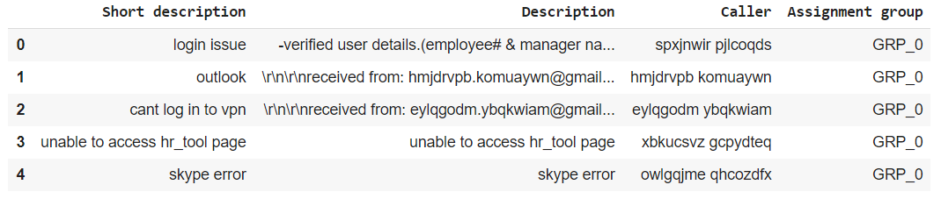
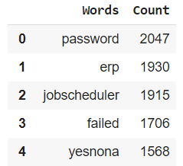
Dataset characteristics
8500 tickets overall among 74 assignment groups
Contains NULL values – data cleansing required
Tickets in multiple languages – English language tickets will be automated.
Nearly half the tickets assigned to GRP_0
Multiple groups with low ticket count – data balancing required
Consist of 2950 distinct Callers
Top Frequent Words

Slide 6
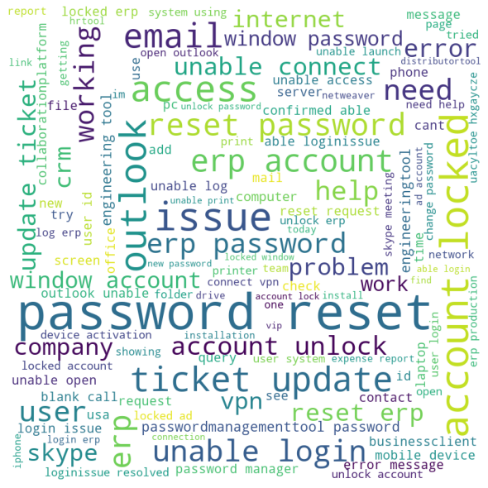

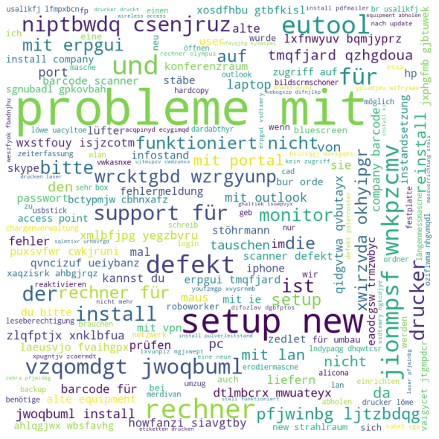
Top 3 Assignment-Group Word-Cloud
Group 0 – Login issue
Group 8 – Job Scheduling
Group 24 – Needs Translation

Slide 7
Model Selection
Improvised-Model Performance
All Statistical Models
Multinomial Logistic Regression
Eliminating based on time
Multinomial Logistic Regression
Eliminating based on performance
Multinomial Logistic Regression
Support Vector Machine
Multinomial Naïve Bayes
K-Nearest Neighbors
Random Forest
Decision Tree
Stochastic Gradient Descent
XGBoost
Random Forest
Decision Tree
Random Forest
Neural Network
Neural Network
Neural Network
LSTM
LSTM
LSTM
Model | Validation Accuracy
Neural Network | 93.21
Random forest | 92.19
Multinomial Logistic Regression | 90.58
LSTM with GloVe | 85.16
LSTM with word2vec | 84.84
Best Model
Neural Network performs the best when evaluated based on
F1-Score – 92.58%
Cohen Kappa Score – 93.96%
Model Selection Approach

Slide 8
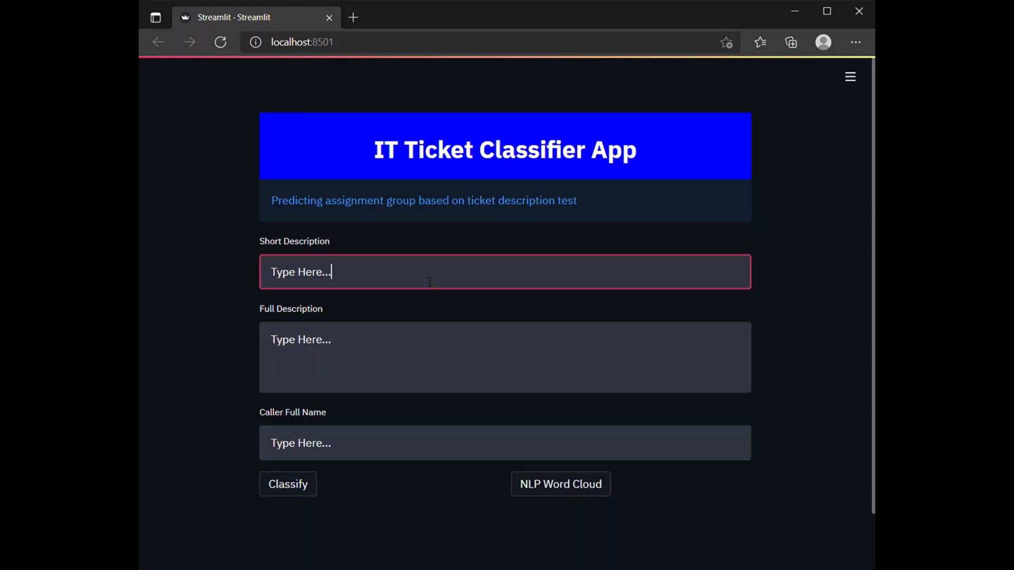
Machine Learning app

Slide 9
Conclusion
S. no | Drawbacks | Reason | Future Scope
1 | Non-English tickets need to be translated manually | Automating translation of huge dataset using Google API is challenging | Research and overcome the challenge of automatic translation
2 | Failing prediction of assignment groups clubbed into miscellaneous group | High imbalance in the no of tickets per assignment group | Create a separate prediction for tickets classified under miscellaneous as well as work on getting more training tickets under these groups.
3 | Unable to perform advance sampling methods and use models like LSTM and Advance models | Shortage of RAM space and absence of parallel processing | Use higher RAM size and multiple processors

Slide 10
THANK YOU

